Slide 1
Sec:2.3 (Burden&Faires)
Newton’s Method and Its Extensions

Slide 2








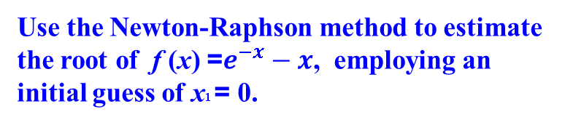





Sec: 2.3 Newton’s Method and Its Extensions
THE NEWTON-RAPHSON METHOD is a method for finding successively better approximations to the roots (or zeroes) of a function.
Algorithm
Example
Use the Newton-Raphson method to estimate the root of f (x) =$e^{−x}−x$, employing an initial guess of x1 = 0.
To approximate the roots of
$$f\left(x\right)=0$$
Given initial guess $x_{1}$
f (x) =$e^{−x}−x$
$${f^{′}\left(x\right)=−e}^{−x}−1$$
$$x_{n}=x_{n−1}−\frac{f(x_{n−1})}{f′(x_{n−1})}$$
$$x_{1}=0$$
f (0) =$1$
$${f^{′}\left(0\right)=}^{}−2$$
$$n$$
$$x_{n}$$
$$x_{2}=x_{1}−\frac{f(x_{1})}{f′(x_{1})}$$
1 0.000000000000000
2 0.500000000000000
3 0.566311003197218
4 0.567143165034862
5 0.567143290409781
$$x_{2}=0−\frac{f(0)}{f′(0)}$$
$$=0.5$$
The true value of the root: 0.56714329.Thus, the approach rapidly converges on the true root.

Slide 3

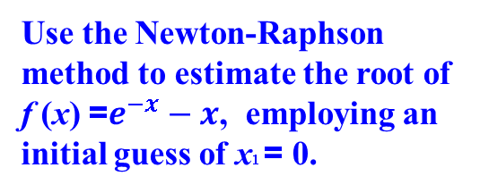
Sec:3.4 Newton’s Method and Its Extensions
THE NEWTON-RAPHSON METHOD is a method for finding successively better approximations to the roots (or zeroes) of a function.
Example
Use the Newton-Raphson method to estimate the root of f (x) =$e^{−x}−x$, employing an initial guess of x1 = 0.
clear
f = @(x) exp(-x) - x;
df = @(x) - exp(-x) - 1;
xr = 0.56714329;
x(1) = 0;
for i=1:4
x(i+1) = x(i) - f( x(i) )/df( x(i) );
end
x'
$$n$$
$$x_{n}$$
1 0.000000000000000
2 0.500000000000000
3 0.566311003197218
4 0.567143165034862
5 0.567143290409781

Slide 4




Sec:3.4 Newton’s Method and Its Extensions
Example
clear
f = @(x) cos(x) - x;
df = @(x) - sin(x) - 1;
x(1) = pi/4;
for i=1:3
x(i+1) = x(i) - f( x(i) )/df( x(i) );
end
x'
Approximate a root of
f (x) =$cosx − x$ using
a fixed-point method, and
Newton’s Method
employing an initial guess of $x1 = \frac{π}{4}$
$$n$$
$x_{n}$(Fixed)
$x_{n}$(Newton)
1
2
3
4
5
6
7
8
0.785398163397448
0.707106781186548
0.760244597075630
0.724667480889126
0.748719885789484
0.732560844592242
0.743464211315294
0.736128256500852
0.785398163397448
0.739536133515238
0.739085178106010
0.739085133215161
clear; clc; format long
x(1) = pi/4;
g = @(x) cos(x);
for k=1:7
x(k+1) = g( x(k) );
end
x'
This Example shows that Newton’s method can provide extremely accurate approximations with very few iterations. For this example, only one iteration of Newton’s method was needed to give better accuracy than 7 iterations of the fixed-point method.

Slide 5





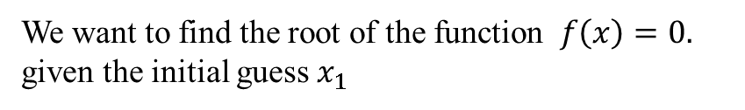






Sec:3.4 Newton’s Method and Its Extensions
Derivation of the method:
$$f\left(x_{1}\right)+\frac{f^{′}\left(x_{1}\right)}{1!}\left(x−x_{1}\right)=0$$
We want to find the root of the function $f\left(x\right)=0.$ given the initial guess $x_{1}$
$$x=x_{1}−\frac{f(x_{1})}{f′(x_{1})}$$
Solve for x
First order approximation with center $x_{1}$
$$x_{2}=x_{1}−\frac{f(x_{1})}{f′(x_{1})}$$
$$f\left(x\right)=f\left(x_{1}\right)+\frac{f^{′}\left(x_{1}\right)}{1!}h+\frac{f^{\left(2\right)}\left(ξ\right)}{2!}h^{2}$$
First order approximation with center $x_{2}$
We approximate the function as
$$f\left(x\right)≈f\left(x_{2}\right)+\frac{f^{′}\left(x_{2}\right)}{1!}(x−x_{2})$$
$$f\left(x\right)≈f\left(x_{1}\right)+\frac{f^{′}\left(x_{1}\right)}{1!}(x−x_{1})$$
Solve for x
Instead of finding the root of $f\left(x\right)$
we will find the roots of the approximation
$$f\left(x_{1}\right)+\frac{f^{′}\left(x_{1}\right)}{1!}\left(x−x_{1}\right)=0$$
$$x_{3}=x_{2}−\frac{f(x_{2})}{f′(x_{2})}$$

Slide 6
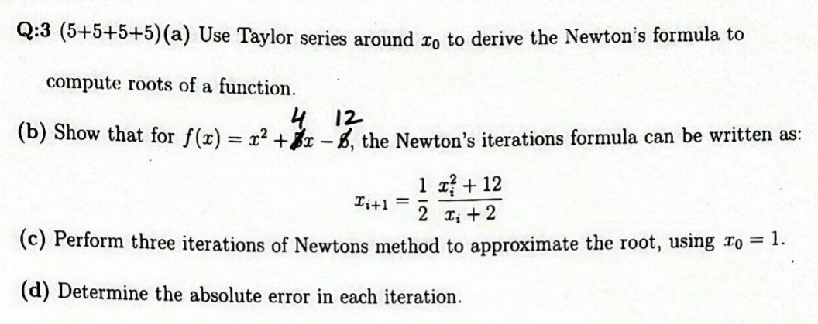
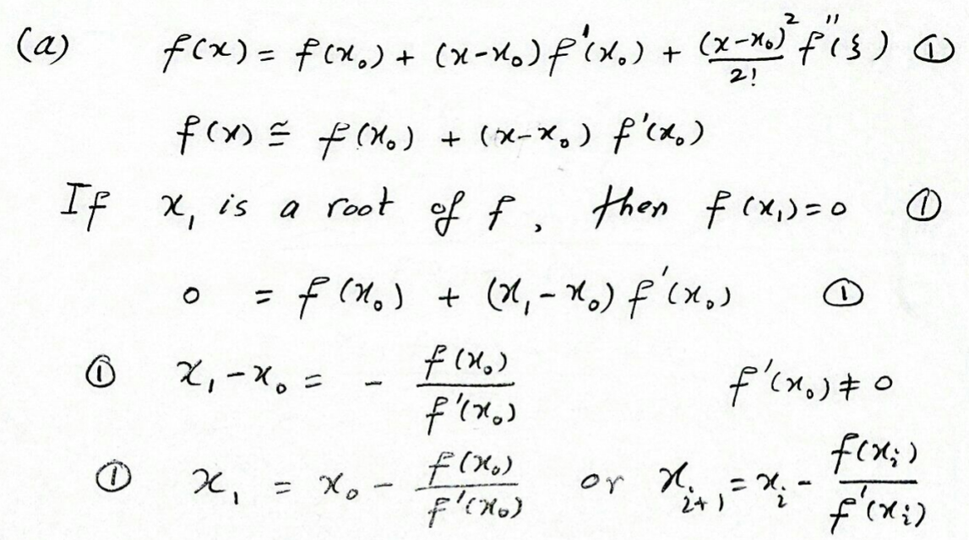
Sec:3.4 Newton’s Method and Its Extensions

Slide 7
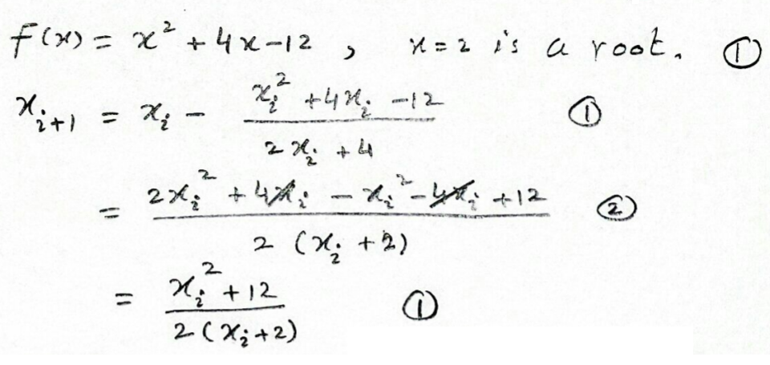
Sec:3.4 Newton’s Method and Its Extensions

Slide 8
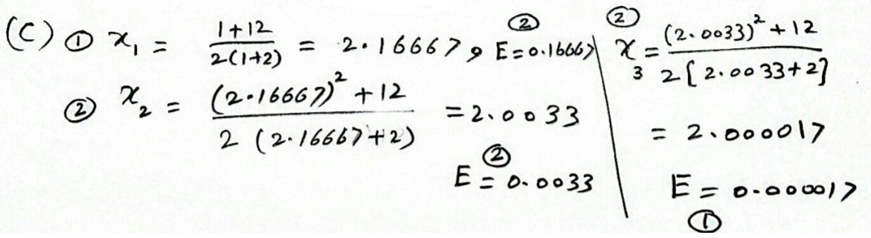
Sec:3.4 Newton’s Method and Its Extensions

Slide 9
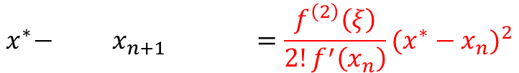

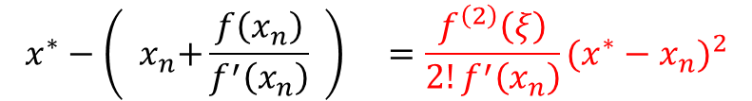




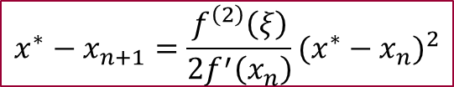
Sec:3.4 Newton’s Method and Its Extensions
Quadratic Convergence:
the error is roughly proportional to the square of the previous error.
First order approximation with center $x_{n}$
$$f\left(x\right)=f\left(x_{n}\right)−\frac{f^{′}\left(x_{n}\right)}{1!}(x−x_{n})+\frac{f^{\left(2\right)}\left(ξ\right)}{2!}{(x−x_{n})}^{2}$$
Subsitute $x= x^{∗}$ the exact root of the function
$$f\left(x^{∗}\right)=f\left(x_{n}\right)−f^{′}\left(x_{n}\right)(x^{∗}−x_{n})+\frac{f^{\left(2\right)}\left(ξ\right)}{2!}{(x^{∗}−x_{n})}^{2}$$
The left hand side is zero
$$0=f\left(x_{n}\right)−f^{′}\left(x_{n}\right)(x^{∗}−x_{n})+\frac{f^{\left(2\right)}\left(ξ\right)}{2!}{(x^{∗}−x_{n})}^{2}$$
$$x^{∗}−{\left({ x}_{n}+\frac{f\left(x_{n}\right)}{f^{′}\left(x_{n}\right)} \right) }_{}=\frac{f^{\left(2\right)}\left(ξ\right)}{2!f^{′}\left(x_{n}\right)}{(x^{∗}−x_{n})}^{2}$$
$$x^{∗}−{ x}_{n+1} =\frac{f^{\left(2\right)}\left(ξ\right)}{2!f^{′}\left(x_{n}\right)}{(x^{∗}−x_{n})}^{2}$$
$$x^{∗}−x_{n+1}=\frac{f^{\left(2\right)}\left(ξ\right)}{2f^{′}\left(x_{n}\right)}{(x^{∗}−x_{n})}^{2}$$

Slide 10


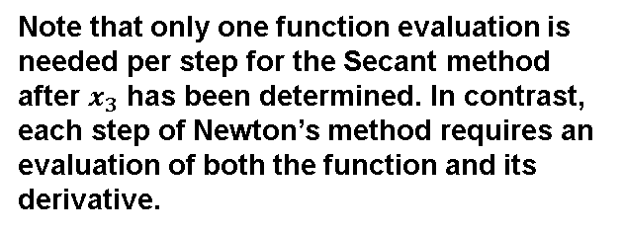



Sec:3.4 Newton’s Method and Its Extensions
The Secant Method
Newton’s method is an extremely powerful technique, but it has a major weakness: the need to know the value of the derivative of f at each approximation. Frequently, f(x) is far more difficult and needs more arithmetic operations to calculate than f (x).
Newton method
The Secant Method
$$x_{n}=x_{n−1}−\frac{f(x_{n−1})}{f′(x_{n−1})}$$
$$x_{n}=x_{n−1}−\frac{f(x_{n−1})(x_{n−1}−x_{n−2})}{f\left(x_{n−1}\right)−f(x_{n−2})}$$
Derivative definition
$$f^{′}\left(x_{n−1}\right)=\lim_{}{\frac{f\left(x_{}\right)−f(x_{n−1})}{x_{}−x_{n−1}}}$$
We need to Start with two initial approximations $x_{1}$ and $x_{2}$.
Note that only one function evaluation is needed per step for the Secant method after $x_{3}$ has been determined. In contrast, each step of Newton’s method requires an evaluation of both the function and its derivative.
Derivative approximation
$$f^{′}\left(x_{n−1}\right)≈ \frac{f\left(x_{n−1}\right)−f(x_{n−2})}{x_{n−1}−x_{n−2}}$$

Slide 11
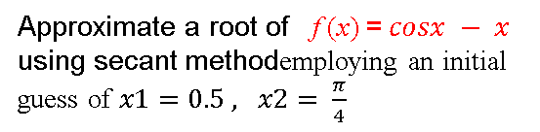





Sec:2.3 Newton’s Method and Its Extensions
The Secant Method
x(1) = 0.5; x(2) = pi/4;
f = @(x) cos(x) - x ;
for k=2:7
x(k+1)=x(k)-f(x(k))*(x(k)-x(k-1))/(f(x(k))-f(x(k-1)));
end
x'
$$x_{n}=x_{n−1}−\frac{f(x_{n−1})(x_{n−1}−x_{n−2})}{f\left(x_{n−1}\right)−f(x_{n−2})}$$
Example
Approximate a root of f (x) =$cosx − x$ using secant methodemploying an initial guess of $x1=0.5 , x2= \frac{π}{4}$
Comparing the results from the Secant method and Newton’s method, we see that the Secant method approximation x6 is accurate to the tenth decimal place, whereas Newton’s method obtained this accuracy by x4. For this example, the convergence of the Secant method is much faster than functional iteration but slightly slower than Newton’s method. This is generally the case.
$$n$$
$x_{n}$(Fixed)
$x_{n}$(Newton)
$x_{n}$(Secant)
1
2
3
4
5
6
7
8
0.785398163397448
0.707106781186548
0.760244597075630
0.724667480889126
0.748719885789484
0.732560844592242
0.743464211315294
0.736128256500852
0.785398163397448
0.739536133515238
0.739085178106010
0.739085133215161
0.500000000000000
0.785398163397448
0.736384138836582
0.739058139213890
0.739085149337276
0.739085133215065
0.739085133215161
0.739085133215161

Slide 12

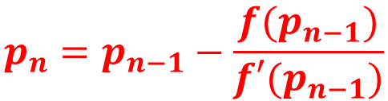


Sec:3.4 Newton’s Method and Its Extensions
Textbook notations
Use $p$ instead of $x$
$$x_{n}=x_{n−1}−\frac{f(x_{n−1})}{f′(x_{n−1})}$$
$$p_{n}=p_{n−1}−\frac{f(p_{n−1})}{f′(p_{n−1})}$$
Textbook notations
Initial guess is $p_{0}$ not $p_{1}$
matlab does not allow to start vector index from 0?

Slide 13
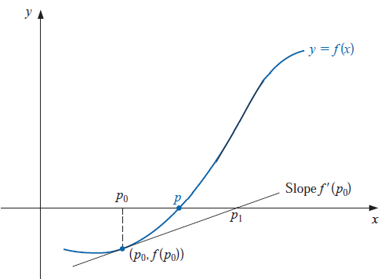
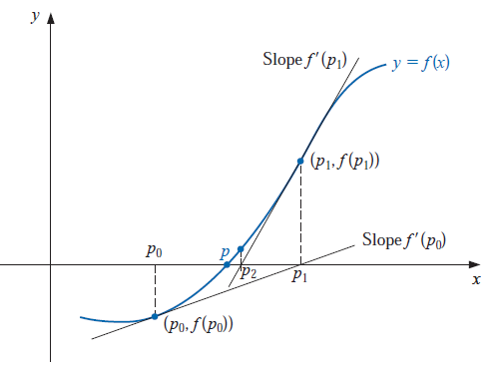

Sec:3.4 Newton’s Method and Its Extensions
Newton method
$$p_{n}=p_{n−1}−\frac{f(p_{n−1})}{f′(p_{n−1})}$$
The Figure illustrates how the approximations are obtained using successive tangents.
Starting with the initial approximation p0,
The approximation p1 is the x-intercept of the tangent line to the graph of f at ( p0, f ( p0)).
The approximation p2 is the x-intercept of the tangent line to the graph of f at ( p1, f ( p1)) and so on.

Slide 14
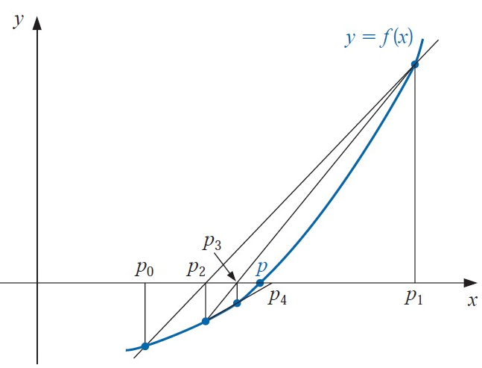
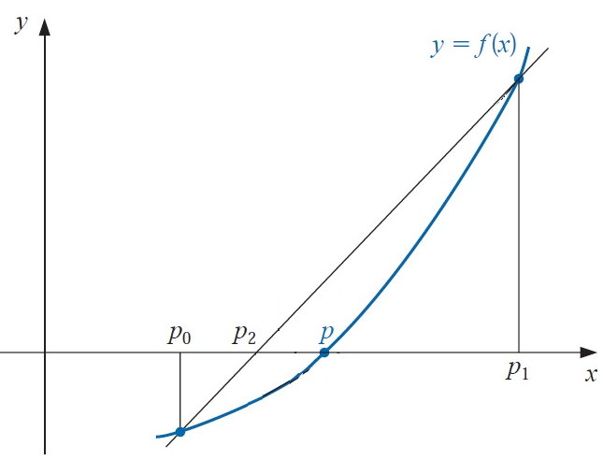

Sec:3.4 Newton’s Method and Its Extensions
Secant method
$$x_{n}=x_{n−1}−\frac{f(x_{n−1})(x_{n−1}−x_{n−2})}{f\left(x_{n−1}\right)−f(x_{n−2})}$$
Starting with the two initial approximations p0 and p1, the approximation p2 is the
x-intercept of the line joining ( p0, f ( p0)) and ( p1, f ( p1)).

Slide 15

Sec:3.4 Newton’s Method and Its Extensions
The Secant Method
$$x_{n}=x_{n−1}−\frac{f(x_{n−1})(x_{n−1}−x_{n−2})}{f\left(x_{n−1}\right)−f(x_{n−2})}$$
Code Optimization
x(1) = 0.5; x(2) = pi/4;
f = @(x) cos(x) - x ;
for k=2:1000
x(k+1)=x(k)-f(x(k))*(x(k)-x(k-1))/(f(x(k))-f(x(k-1)));
end
x'
x1 = 0.5; x2 = pi/4;
f = @(x) cos(x) - x ;
fx1 = f(x1); fx2 = f(x2);
for k=2:1000
x3 =x2 - fx2*(x2-x1)/(fx2-fx1);
x1 =x2; x2=x3;
fx1=fx2; fx2=f(x2);
end
x2
Memory and function evaluation reduction

Slide 16
Sec:3.4 Newton’s Method and Its Extensions
Memory and function evaluation reduction
clc; clear
tic
x(1) = 0.5; x(2) = pi/4;
f = @(x) cos(x) - x ;
for k=2:7
x(k+1)=x(k)-f(x(k))*(x(k)-x(k-1))/(f(x(k))-f(x(k-1)));
end
x(8)
toc
tic
clear
x1 = 0.5; x2 = pi/4;
f = @(x) cos(x) - x ;
fx1 = f(x1); fx2 = f(x2);
for k=2:7
x3 =x2 - fx2*(x2-x1)/(fx2-fx1);
x1 =x2; x2=x3;
fx1=fx2; fx2=f(x2);
end
x2
toc
Output
ans =
0.739085133215161
Elapsed time is 0.004726 seconds.
x2 =
0.739085133215161
Elapsed time is 0.000554 seconds.

Slide 17

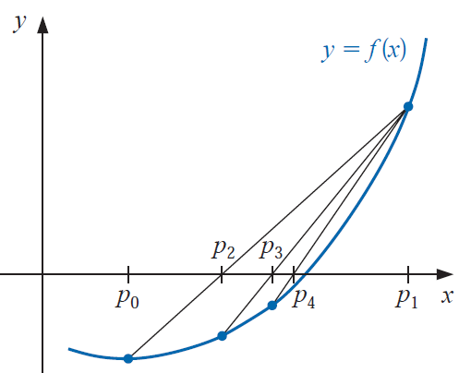
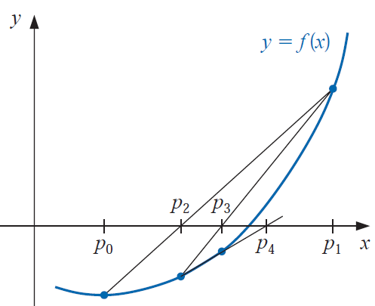
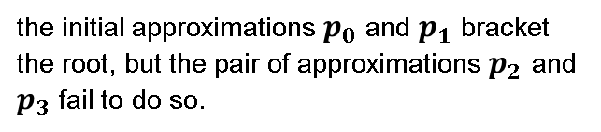




Sec:3.4 Newton’s Method and Its Extensions
The Method of False Position
The method of False Position generates approximations in the same manner as the Secant method, but it includes a test to ensure that the root is
always bracketed between successive iterations.
Each successive pair of approximations in the Bisection method brackets a root p of the equation.
$$p_{n}$$
$$p$$
$$p_{n+1}$$
Root bracketing
Root bracketing is not guaranteed for either Newton’s method or the Secant method.
Secant method
the initial approximations $p_{0}$ and $p_{1}$ bracket the root, but the pair of approximations $p_{2}$ and $p_{3}$ fail to do so.
${p∉[p}_{2}, p_{3}]$ but ${p∈[p}_{3}, p_{1}]$

Slide 18
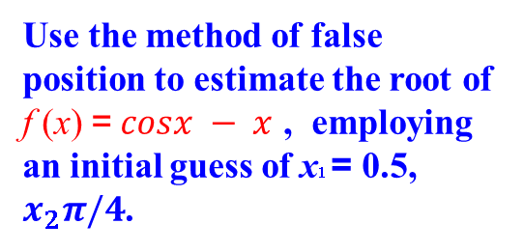

Sec:3.4 Newton’s Method and Its Extensions
Example
Use the method of false position to estimate the root of f (x) =$cosx − x$ , employing an initial guess of x1 = 0.5, $x_{2}π/4$.
Remark
Notice that the False Position and Secant approximations agree through p3
$$n$$
False Position
Secant
Newton
0 0.5 0.5 0.7853981635
1 0.7853981635 0.7853981635 0.7395361337
2 0.7363841388 0.7363841388 0.7390851781
3 0.7390581392 0.7390581392 0.7390851332
4 0.7390848638 0.7390851493 0.7390851332
5 0.7390851305 0.7390851332
6 0.7390851332
Remark
the method of False Position requires an additional iteration to obtain the same accuracy as the Secant method.

Slide 19
Sec:3.4 Newton’s Method and Its Extensions
Secant method
x1 = 0.5; x2 = pi/4;
f = @(x) cos(x) - x ;
fx1 = f(x1); fx2 = f(x2);
for k=2:7
x3 =x2 - fx2*(x2-x1)/(fx2-fx1);
fx3 = f(x3);
x1 =x2; x2=x3;
fx1=fx2; fx2=fx3;
end
x2
Modify the code to perform false position
clear; clc;
x1 = 0.5; x2 = pi/4;
f = @(x) cos(x) - x ;
fx1 = f(x1); fx2 = f(x2);
for k=2:7
x3 =x2 - fx2*(x2-x1)/(fx2-fx1);
fx3 = f(x3);
if fx3*fx2 < 0;
x1 = x2; fx1 = fx2;
end
x2 =x3; fx2=fx3;
end
x2

Slide 20





Sec:3.4 Newton’s Method and Its Extensions
Stopping Criteria
Error
$$\left|x_{r}−x_{n}\right|<ε$$
$$\left|x_{n+1}−x_{n}\right|<ε$$
$$\frac{\left|x_{r}−x_{n}\right|}{\left|x_{r}\right|}<ε$$
$$\frac{\left|x_{n+1}−x_{n}\right|}{\left|x_{n+1}\right|}<ε$$
Residual
clear; clc;
x1 = 0.5; x2 = pi/4;
f = @(x) cos(x) - x ;
fx1 = f(x1); fx2 = f(x2);
for k=2:7
x3 =x2 - fx2*(x2-x1)/(fx2-fx1);
fx3 = f(x3);
if fx3*fx2 < 0;
x1 = x2; fx1 = fx2;
end
x2 =x3; fx2=fx3;
end
x2
$$\left|f(x_{n})\right|<tol$$

Slide 21

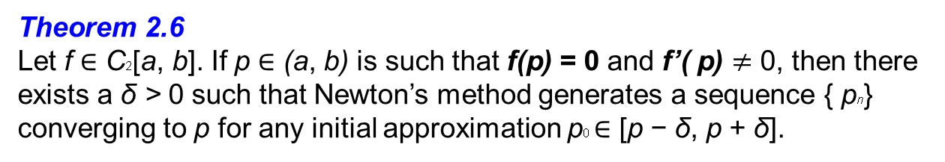


Sec:3.4 Newton’s Method and Its Extensions
Theorem 2.6
Let f ∈ C2[a, b]. If p ∈ (a, b) is such that f(p) = 0 and f’( p) $≠$ 0, then there exists a δ > 0 such that Newton’s method generates a sequence { pn} converging to p for any initial approximation p0 ∈ [p − δ, p + δ].
Proof
p + δ
p - δ
p
$$x_{n}=x_{n−1}−\frac{f(x_{n−1})}{f′(x_{n−1})}$$
$$x_{n}={g(x}_{n−1})$$
$$g(x)=x−\frac{f(x)}{f′(x)}$$

